Slide 1
Full-Stack Web Development Lecture 3: Interacting with Databases Ashley Williams Ashley.Williams@mmu.ac.uk

Slide 2
Learning Objectives
To learn how to use Joi to validate data easily
To learn a scalable way to structure applications
To learn how to persist data to SQLite databases

Slide 3
Unit Overview
# | W/C | Lecture | Lab
1 | 03/10/2022 | Introduction to Full-Stack | Recap/RESTful APIs
2 | 10/10/2022 | Introduction to NodeJS/ExpressJS | Getting started with NodeJS/ExpressJS
3 | 17/10/2022 | Interacting with Databases | Interacting with Databases
4 | 24/10/2022 | Handling Authentication | Handling Authentication
5 | 31/10/2022 | Version Control | Assignment Support: Backend
6 | 07/11/2022 | API Security and Scaling | Assignment Support: Backend
7 | 14/11/2022 | Introduction to VueJS | VueJS Basics
8 | 21/11/2022 | Style, Layout, and Navigation | Layout and Navigation
9 | 28/11/2022 | Networking | Handling API requests
10 | 05/12/2022 | Structuring and Refactoring | Assignment Support: Front-end
11 | 12/12/2022 | Code Quality | Assignment Support: Front-end

Slide 4
What do we know? What comes next?
Last week we learned how to create basic Express apps
We can create routes and parameters
Access data that is sent to those routes
Send a response to the client
What’s next?
We want to do something with that data – normally a DB interaction
We first need to validate that the data is correct against the specification…

Slide 5
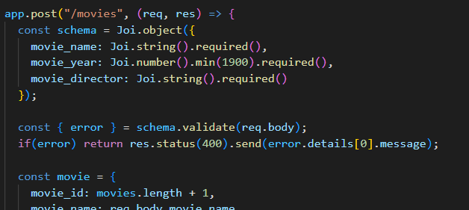
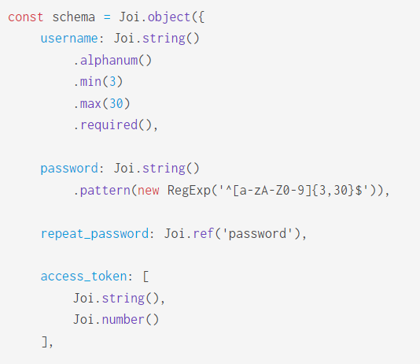
The Joi of data validation
Joi is a library used for handling data validation
Install with “npm install --save joi”
Require it in at the top of your app file
Steps for using Joi:
Create a Joi schema
Compare incoming objects with the schema
Handle any errors
Documentation: https://joi.dev/api/?v=17.6.1
(Very powerful)

Slide 6
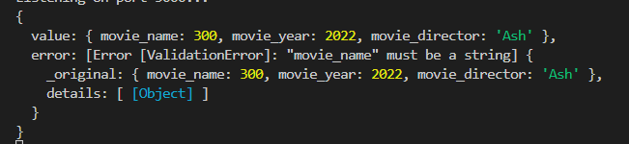
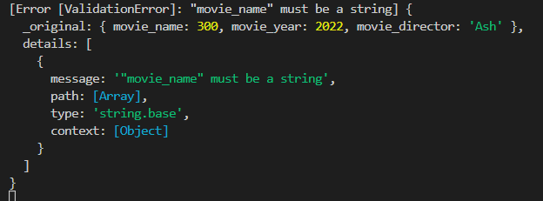
The Joi of data validation
What’s going on with these two lines?
The first line “deconstructs” the output of the function, to only pull out the bit that we are interested in (the error details)
The second line says that if there is an error, return a 400 (bad request) response with the details of the first error found (there may be multiple errors).

Slide 7
Data validation - That’s all folks!
Other methods are available, but Joi is so simple that its perfect for this level of complexity
You’ll find that once you learn the basics of any language, the best answer is always – “there’s a library that will do all of that for you”
If we now look at the moviedb code from last year, you will now understand every line – yay!

Slide 8
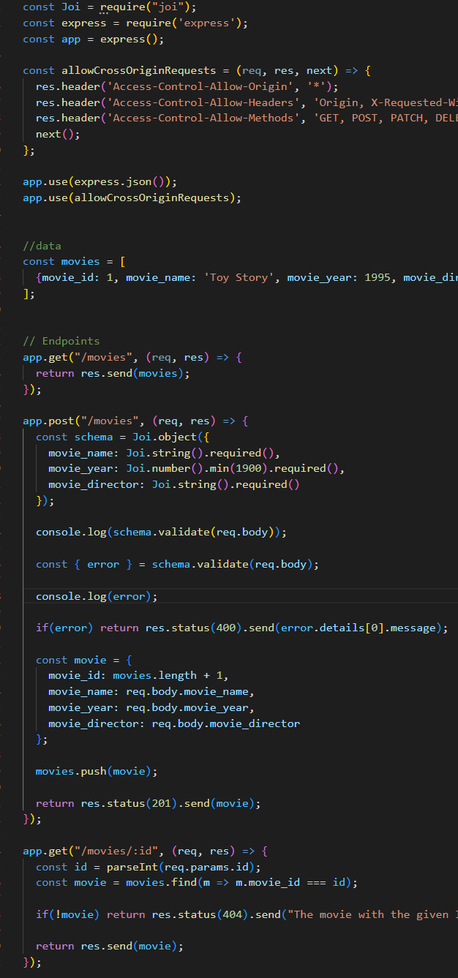
MovieDB – but there is still a problem…
We’ve covered every line of code here…
Therefore, you can build apps of similar scale/complexity
But – no persistence
Data is lost every time we restart the server…
….we need a database.

Slide 9
SQLite
A library that implements a small, fast, self-contained, high-reliability, full-featured SQL DB engine
Essentially a full SQL DB, saved on a single file, and interacted with using a simple library
Perfect for small applications (e.g. web/mobile apps and assignments)
In NodeJS, we can use “npm install --save sqlite3”

Slide 10
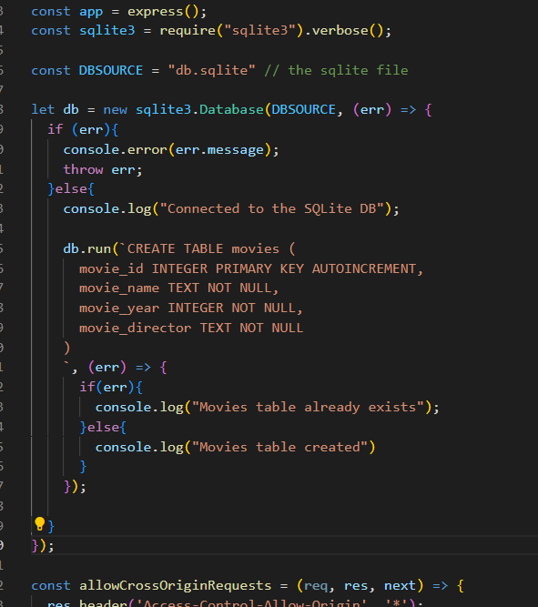
MovieDB with an actual DB: The set up…
Connect to the DB
If it works, create the tables
It will try to do this every time you run the app, meaning if you want a fresh database, just delete the file
This is done for you in the assignment!

Slide 11
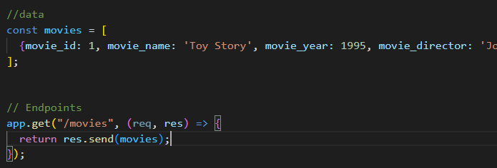
MovieDB with an actual DB: GET /movies
The original version:
We can delete the array
We need the GET to use the DB
What will the SQL query be here?

Slide 12
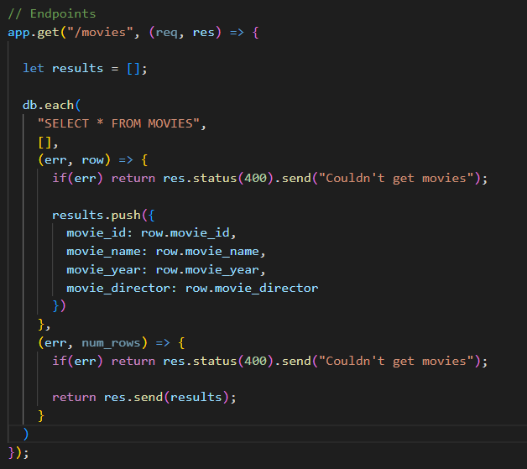
MovieDB with an actual DB: GET /movies
db.each() function
Four parameters:
SQL statement
SQL parameters
Function for each row
Function when complete

Slide 13
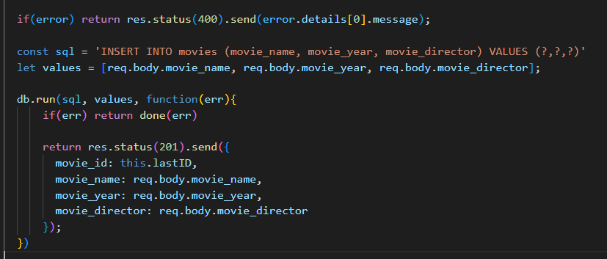
MovieDB with an actual DB: POST /movies
We keep all of the validation
But instead of adding to the array, we add to the DB
db.run()
3 parameters:
SQL Statement
Parameters
Function to handle results
Why wouldn’t we use arrow functions here like we have been doing elsewhere?

Slide 14
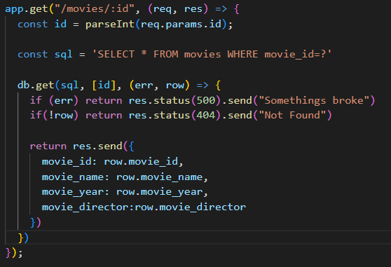
MovieDB with an actual DB: GET /movies/:id
Instead of searching through the array, we get from the DB using the ID in the path parameter
db.get()
3 parameters:
SQL Statement
Parameters
Function to handle result

Slide 15
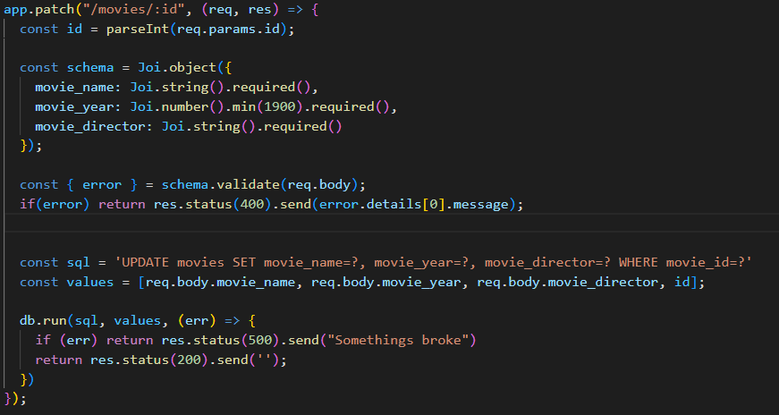
MovieDB with an actual DB: PATCH /movies/:id
Instead of searching through the array, we get from the DB using the ID in the path parameter
Keep all validation through Joi
db.run()
3 parameters:
SQL Statement
Parameters
Function to handle result

Slide 16
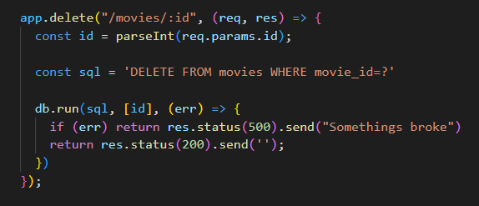
MovieDB with an actual DB: DELETE /movies/:id
Instead of searching through the array, we get from the DB using the ID in the path parameter
db.run()
3 parameters:
SQL Statement
Parameters
Function to handle result

Slide 17
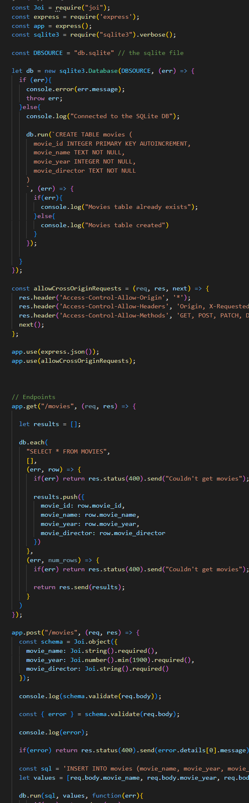
MovieDB – let’s clean it up…
So we can now validate data and persist it to a database – everything a server application needs to do
However, it’s starting to get big and clunky while it's all in one file
Break out using the Model View Controller (MVC) pattern
Divides related program logic into three interconnected elements
View – the bits that are visible to the user (in this case, the routes)
Controller – handles all of the validation and logic
Model – handles the DB interactions

Slide 18
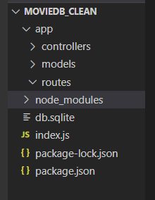
MovieDB – let’s clean it up…
First, create a directory for each of your routes, controllers, and models
I like to separate out the different parts of the application (e.g., for the assignment, I’d have a different route/model/controller file for my users, articles, and comments)
I also like to keep all of my app code inside an “app” directory
This is how the assignment starter code is also structured

Slide 19
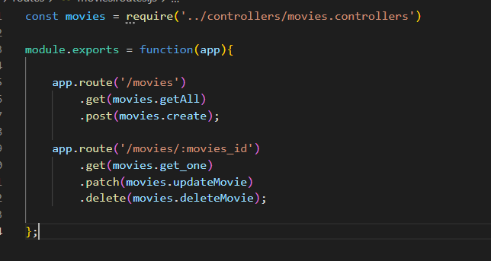

MovieDB – let’s clean it up… Routes
Create a route file for all of the movie routes
In this file, we create each of the routes…
But
We don’t implement them here. Instead we pass them off to functions in the controller (pulled in on line one)
Now, other developers can quickly see what routes exist and where they are implemented
Import the routes file into the index.js file

Slide 20
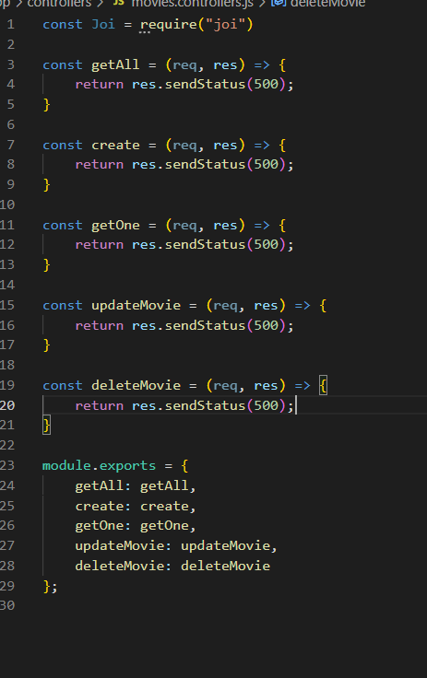
MovieDB – let’s clean it up… Controller
Create the controller file and create the functions called in the routes
At the moment, they are all empty and just return a 500 status
Module.exports at the bottom is how we define which functions can be called by other files (we don’t want to give access to all functions by default – e.g. private methods in Java)

Slide 21
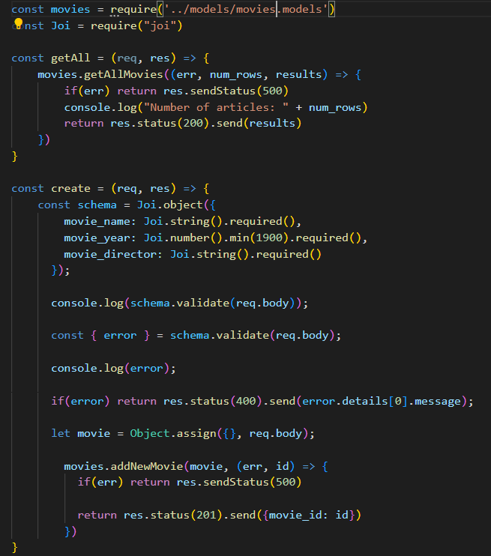
MovieDB – let’s clean it up… Controller
Now we start implementing each of the functions..
Only we don’t want to handle any of the DB logic here…
Instead, we pass off the DB interactions to a model file
Remember: we define how the model functions work
Here we are using callback functions
The function will execute, and then when it is finished, we will execute the callback function

Slide 22
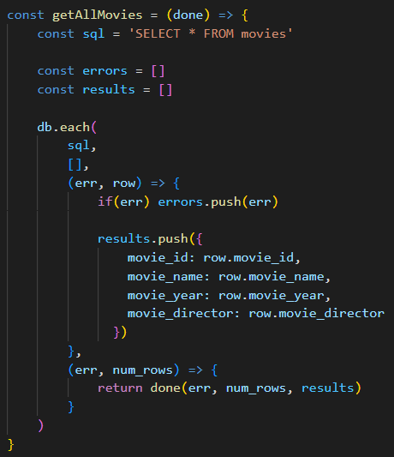
MovieDB – let’s clean it up… Model
Handles the DB interaction
Takes in the callback as a parameter and executes it on completion
Looks complicated, but we’ll go through in more detail in the labs (this week and next week)

Slide 23
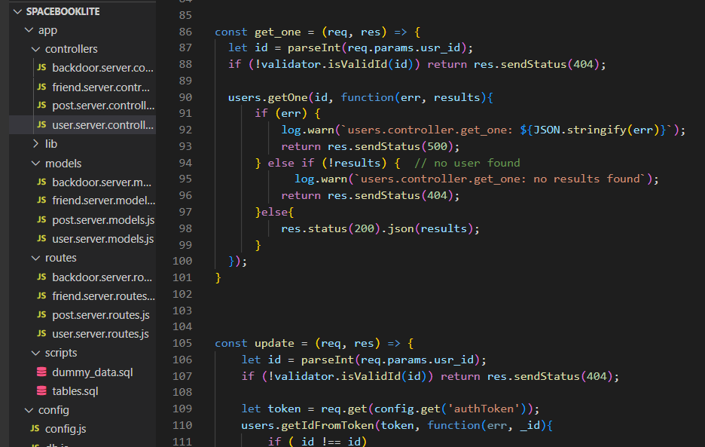
Why bother?
Separation of logic is key for maintainable code
The different parts (model/view/controller) can all independently scale
Reduces code duplication because you can pull in functionality where it's needed

Slide 24
This week’s lab
In this week's lab, you will:
Practice validating data using Joi
Implement a SQLite database for persisting data
Practice structuring your applications in adherence to the MVC pattern
Assignment Checklist:
Implement the 5 article management end-points

Slide 25
Questions?

